Slide 1
COMPUTER ORGANIZATION & ARCHITECTURE
Dr. Farzil Kidwai

Slide 2
Outcome Based Education
Subject: | Computer organization and architecture |  | Max Marks External | 75 Marks
Subject Code: | ETCS 204 |  | Max Marks Internal | 25 Marks
Total Credit: | 4 |  | Evaluation Scheme
Contact Hours: | L 3 |  | Evaluation 75 Marks | End-term Exam
 | T 1 |  | Evaluation 25 Marks | Sessional Exam
Course Objective:
The objective of the subject is to understand the architecture and internal behavior of computer system in details. By this they can design the hardware of a computer.

Slide 3
Course Outcome:
On successful completion of the course, students will be able to:
C204.1:
Understand the computer architecture hardware with the knowledge of register transfer language.
C204.2:
Implement the computer micro operations using RTL and will also be able to have knowledge of 8085 micro processor architecture and instructions.
C204.3:
Understand the design of simple computer with respect of instruction formats, instruction cycle and register set.

Slide 4
Course Outcome:
C204.4:
Have knowledge of various memories that are used in computer systems and also how the data transfer takes place between these memories and internal components of the system.
C204.5:
Understand the concept of parallelism with pipelining at instruction and arithmetic operation level and hardwired and micro-programmed control unit
C204.6:
Learn the binary arithmetic operations and input-output organization.

Slide 5
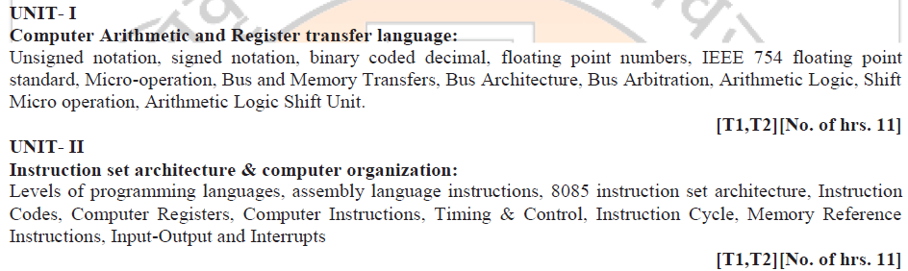
Syllabus

Slide 6
List of Topics
Computer Organization
Computer Architecture
ELEMENTS OF CPU
BUS
Data bus
Address bus
Control bus
Half Adder + Full Adder
Register Transfer Language

Slide 7
COMPUTER ARCHITECTURE AND ORGANIZATION
Computer Architecture – It is concerned with the structure and behavior of the computer as seen by the user. It includes the information formats, the instruction sets, and techniques for addressing memory. The architectural design of a computer system is concerned with the specifications of the various functional modules such as processors and memories and structuring them together into a computer system.
Computer Organization – It is concerned with the way the hardware components operate and the way they are connected together to form a computer system. The various components of the computer system are assumed to be in place and the task is to investigate the organizational structure to verify whether the computer parts are operating as intended.
Computer Design – it is concerned with the hardware design of the computer. Once the computer specifications are formulated, it is the task of the designer to develop hardware for the system. Computer design is concerned with the determination of what hardware should be used and how the parts should be connected. This aspect of computer hardware is sometimes referred to as computer implementation.

Slide 8
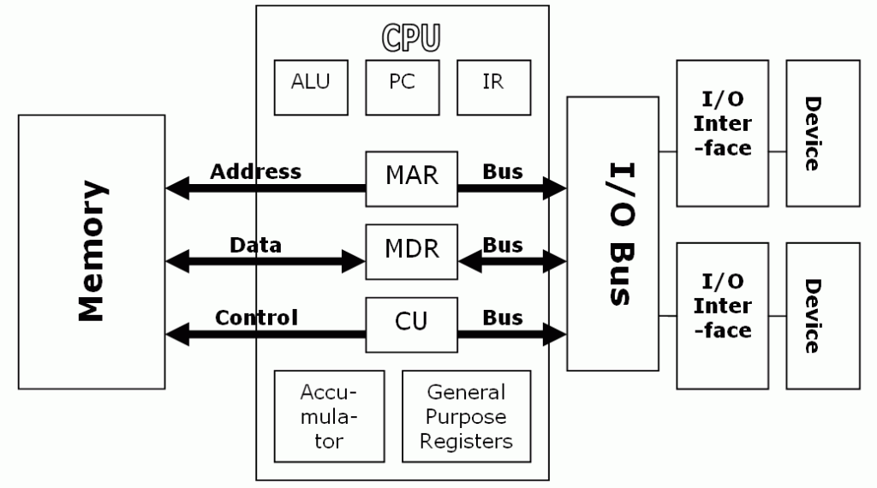
ELEMENTS
Fetch Instruction
NEXT INSTRUCTION
Execute Instruction

Slide 9
CPU REGISTERS
CPU consists of following major registers
Accumulator (AC)
Program counter (PC)
Memory Address Register (MAR)
Memory Buffer Register (MBR)
Instruction Register (IR)
General Purpose Registers (GPR)
I/O Data Register (IODR)
I/O Address Register (IOAR)

Slide 10
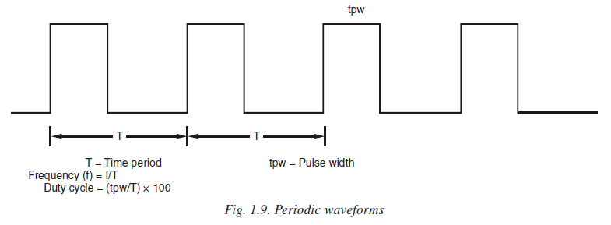
CLOCK
The clock unit generates and supplies a continuous sequence of clock pulses. The clock signal is used as a timing reference by the control unit. The clock signal is a periodic waveform since the waveform repeats itself. The rate at which the periodic waveform repeats is known as the frequency (f ). It is specified as cycles per second (cps) or Hz. The clock frequency is an indication of the internal operating speed of the processor.

Slide 11
CPU BUS
A group of wires connecting two or more devices and providing a path to perform communication is called Bus. A bus that connects major computer components/modules (CPU, Memory, I/O) is called system bus. These system buses are separated into three functional groups:
1. Data bus. 2. Address bus. 3. Control bus.
DATA BUS
The data bus consists of 8, 16, 32 or more parallel lines. The data bus lines are bidirectional. This means that CPU can read data on these lines from memory or from a port as well as data out on these lines to a memory location or to a port.
ADDRESS BUS
It is a unidirectional bus. The address bus consists of 16, 20, 24 or more parallel lines. The CPU sends out the address of the memory location or I/O port that is to be written or read from by using this address bus.
CONTROL BUS
Control lines regulate the activity on the bus. The CPU sends signals on the control bus to enable the outputs of addressed memory device or port device. Figure 1.10 shows a simple bus structure. There are three different buses: data bus, address bus and control bus. The data bus is used for multiple purposes.

Slide 12
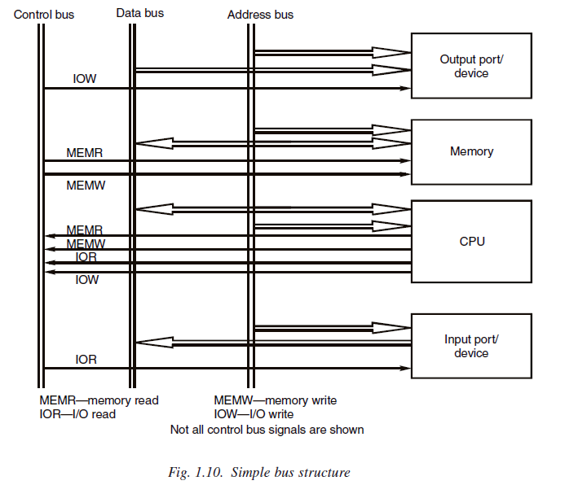

Slide 13
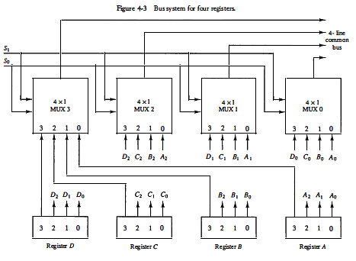
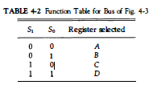
BUS for 4 Register

Slide 14

Three State Buffer
A bus system can be constructed with three-state gates instead of multiplexers. A three-state gate is a digital circuit that exhibits three states. Two of the states are signals equivalent to logic 1 and 0 as in a conventional gate. The third state is a high-impedance state. The high-impedance state behaves like an open circuit, which means that the output is disconnected and does not have a logic significance.

Slide 15
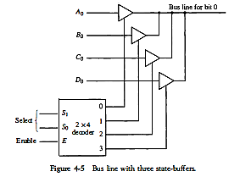
BUS

Slide 16
STORED PROGRAM CONCEPT
Stored program concept is a process to store the instruction in computer memory to enable it to perform a variety of tasks in sequence or intermittently. ‘Stored Program’ was the breakthrough that enabled computer to perform complex tasks in fractions of second. Being able to do arithmetic and evaluate formulas fast would be useless if a person had to keep telling the computer what to do next. The trick was to encoding the list of instructions into numbers that could coexist in the computer’s memory along with data, and having a ‘processor’ build into the machine to decode and execute the instructions. Now the computer could do both, calculations and control of the sequence at electronic speed. The idea was introduced by John Von Neumann, who proposed that a program can be electronically stored in binary-number format in a memory device so that instructions could be modified by the computer as determined by intermediate computational results.

Slide 17
Von Neumann Architecture
A Von Neumann Architecture computer have five parts i.e.,
(a) An arithmetic-logic-unit
(b) A control unit
(c) A memory
(d) Some form of input/output and
(e) a bus that provides a data path between these parts.
The ALU and control unit have usually some temporary storage units known as registers. Each register can be considered as a fast memory with single location. Such registers temporarily store certain information such as instruction, data, address, etc. Storing in registers is advantageous since these can be read quickly compared to fetching them from external memory.

Slide 18
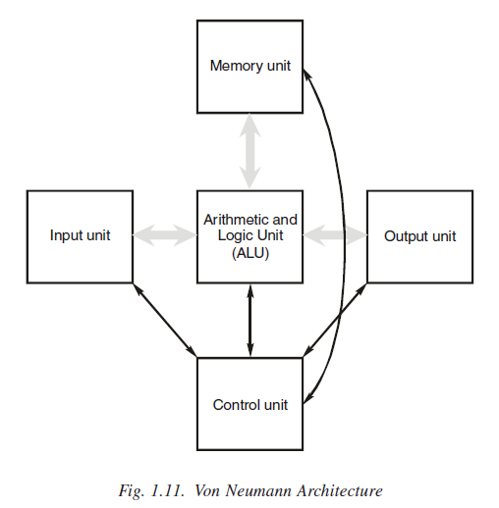
The ALU and control unit are together known as Central Processing Unit (CPU) or processor. The memory and CPU consist of electronic circuits and form the nucleus of the computer. The input and output units are electromechanical units consisting of both electronic circuits and mechanical assemblies. The input and output units are known as peripheral devices.

Slide 19
Architecture
A von Neumann Architecture computer performs following sequence of steps:
1. Fetch the next instruction from memory at the address in the program counter.
2. ADD 1 to the program counter.
3. Decode the instruction using control unit. The control unit commands the rest of the computer to
perform some operation.
4. Go back to step 1.

Slide 20
Limitation in Von Neumann Model
Very few computers have a pure von Neumann architecture. Most computers add another step to check for interrupts, electronic events that could occur at any time. An interrupt resembles the ring of a telephone, calling a person away from some lengthy task. Von Neumann computers spend a lot of time moving data to and from the memory, and this slows the computer. So, often we separate the bus into two or more busses, usually one for instruction and the other for data.

Slide 21
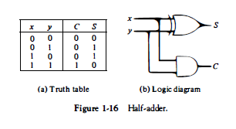

Half Adder

Slide 22
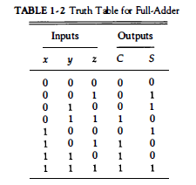
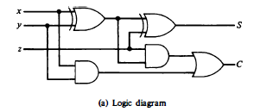

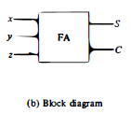
FULL ADDER

Slide 23
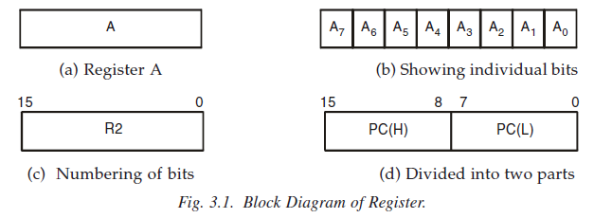
REGISTER TRANSFER LANGUAGE
The internal hardware organization of a digital computer is best defined
by specifying:
1. The set of registers it contains and their function.
2. The sequence of micro-operations performed on the binary information stored in the registers.
3. The control that initiates the sequence of micro-operations.

Slide 24

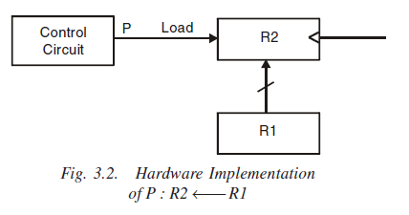
REGISTER TRANSFER LANGUAGE
The symbolic notation used to describe the micro - operation transfer among registers is called a register transfer language.
If we want that the transfer can take place only when certain control condition satisfies, this can be shown by means of an if then statement as

Slide 25
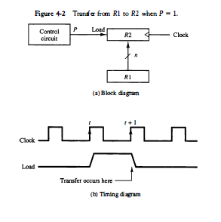
RTL

Slide 26
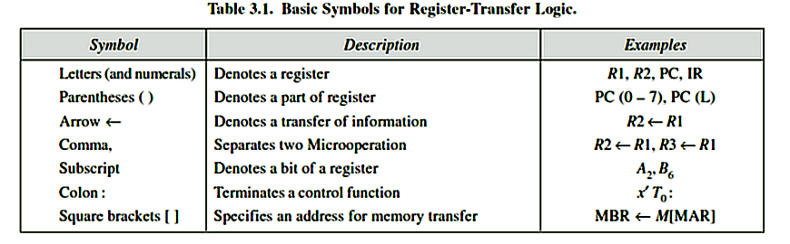
RTL

Slide 27
MICROOPERATION
The operations executed on data stored in registers are called microoperations, for example shift, count, clear, and load. The microoperations are classified into the following four categories:
Data transfer microoperation.
Register transfer microoperations. These micro operations transfer the data from one register to another register.
Memory transfer microoperations. These microoperations transfer data from register tomemory or memory to register.
Arithmetic microoperations. These microoperations perform arithmetic operations on data stored in registers. Addition, subtraction, multiplication, division all are arithmetic microoperations.
Logic microoperations. These microoperations perform bit manipulation operations on nonnumeric data stored in registers.
Shift microoperations. These microoperations shift the data in left or right direction stored in registers.

Slide 28
MICROOPERATIONS
Register transfer means that the contents of one register is transferred to another register. The information transfer from one register to another is designated in symbolic form by using the operators.
The control function is a Boolean function that can be equal to 1 (logic HIGH) or 0 (logic LOW). The control function is terminated by colon. This colon indicates that the transfer operation by executed by the hardware only when the control function is equal 0 or 1 (depending on the logic level).

Slide 29
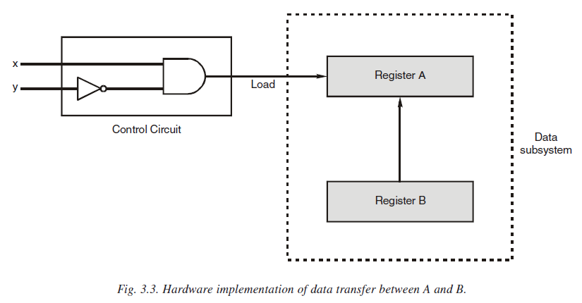
MICROOPERATION

Slide 30
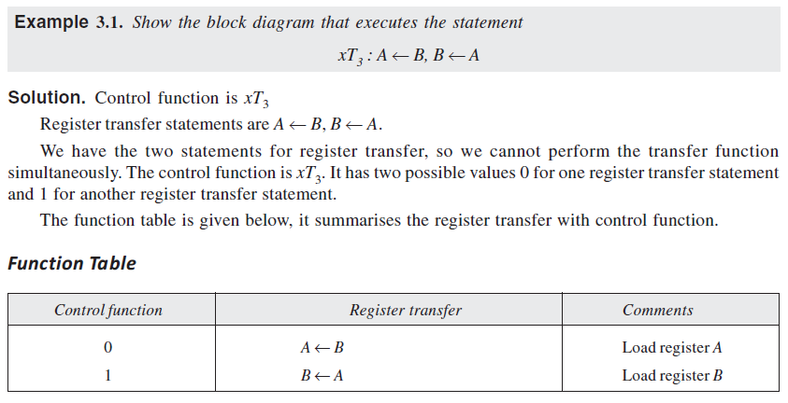

Slide 31
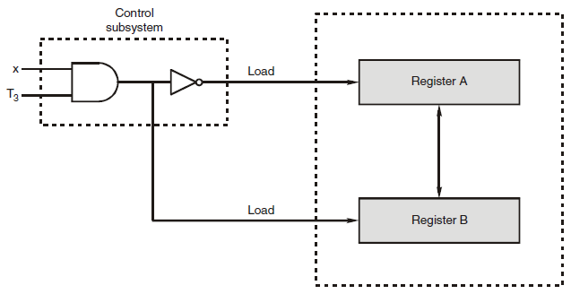
Hardware Implementation

Slide 32
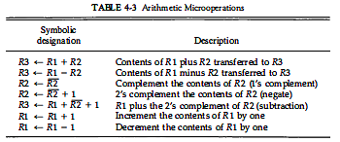
Arithmetic Microoperations

Slide 33
4 BIT ADDER
B₃
A₃
B₂
A₂
B₁
A₁
B₀
A₀
FA
C₃
FA
C₂
FA
C₁
FA
C₀
C₄
S₃
S₂
S₁
S₀
An n-bit binary adder requires n full-adders. The output carry from each full-adder is connected to the input carry of the next-high-order full-adder. The n data bits for the A inputs come from one register (such as R1), and the n data bits for the B inputs come from another register (such as R2). The sum can be transferred to a third register or to one of the source registers (R 1 or R2), replacing its previous content.

Slide 34
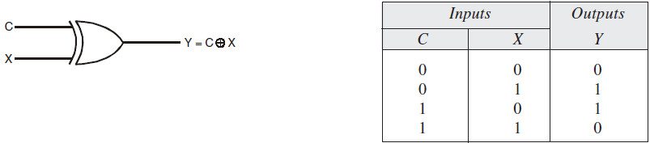
XOR
TRUTH TABLE
XOR GATE

Slide 35
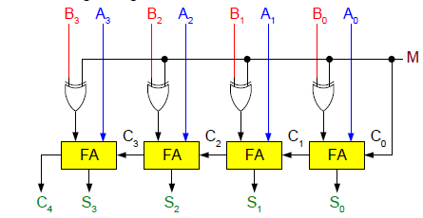
4 BIT ADDER - SUBTRACTOR
CASE 1: M = 1
SUBTRACTOR
CASE 2: M = 0
ADDER

Slide 36
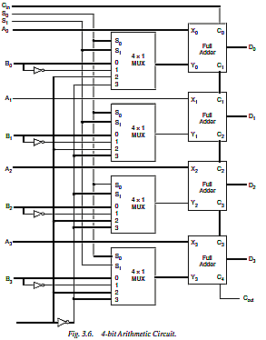
0

Slide 37
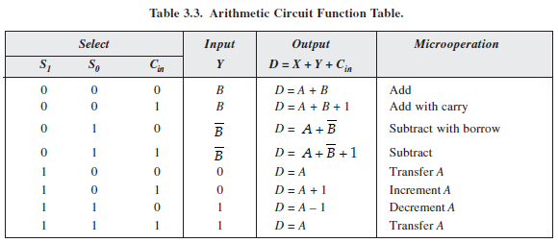
Arithmetic Circuit

Slide 38
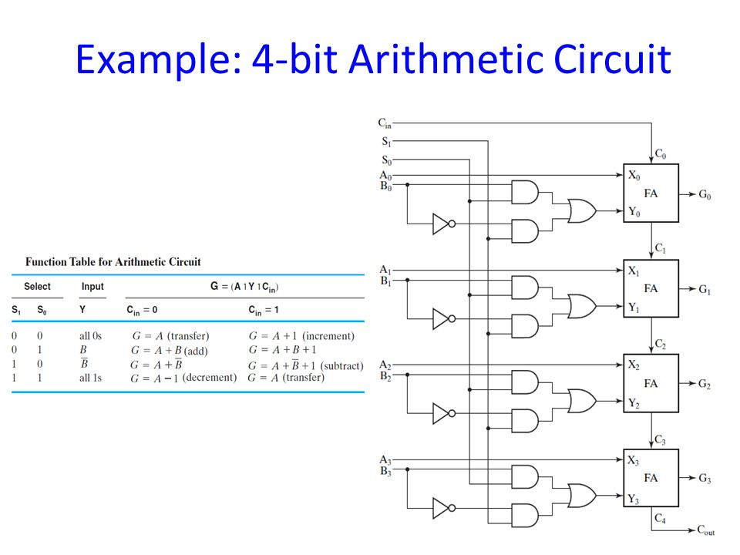

Slide 39

LOGIC MICROOPERATIONS
Logic microoperations specify binary operations for strings of bits stored in registers. These operations consider each bit of the register separately and treat them as binary variables.
+ between P and Q is an OR operation between two binary variables of a control function. The + between R2 and R3 specifies an add microoperation.
The OR microoperation is designated by the symbol V between registers R5 and R6.
The symbol V will be used to denote an OR microoperation and the symbol Ʌ to denote an AND microoperation

Slide 40
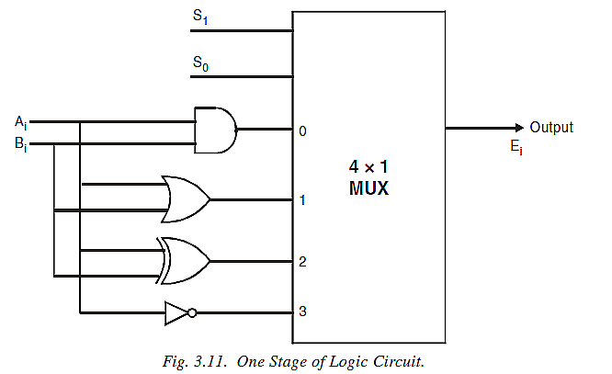
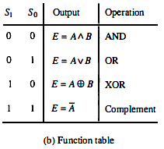
Logic Circuit

Slide 41
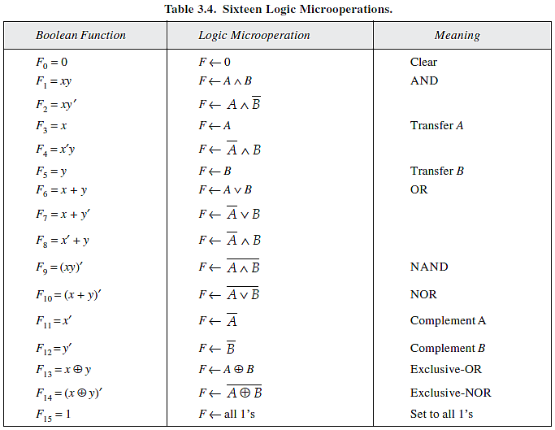
List of Microoperations

Slide 42



Selective Microoperations
Selective Set
The selective-set operation sets to 1 the bits in register A where there are corresponding 1’s in register B. It does not affect bit positions that have 0’s in B.
Selective Complement
The selective-complement operation complements bits in A where there are corresponding 1’s in B. It does not affect bit positions that have 0’s in B.
Selective Clear
The selective-clear operation clears to 0 the bits in A only where there are corresponding 1’s in B.
It is similar to Logic-OR microoperation
It is similar to Exclusive-OR microoperation
It is similar to A ^ B’ microoperation

Slide 43

Mask Operation
The mask operation is similar to the selective-clear operation except that the bits of A are cleared only where there are correspoinding 0’s in B. The mask operation is an AND microoperation.

Slide 44
Shift Microoperations
Shift microoperations are used for serial transfer of data. The shifting of bits of register can be in both direction left or right, during which the first flip-flop receives its binary information from the serial input. When the operation is shift-left, the serial input transfers a bit into the right most position and when the operation is shift-right the bit from the serial input is transferred into the left most position.
Shift Operations are of three types
(a) Logical (b) Circular (c) Arithmetic.

Slide 45
Logical Shift
It is the easiest to perform as the bits are simply shifted to the right or to the left. If it is shift-left, a 0 bit is transferred at the right most position through serial input and the leftmost bit is lost.
Similarly, if it is shift-right the right most bit is lost and a 0 bit is added at the leftmost place.
Example, R1 ← shl R1, R2 ← shr R2.
shl and shr are the symbols used for shift-left and shift-right microoperations. The above two statements specifies a 1-bit shift to the left of the content of register R1 and a 1-bit shift to the right of the content of register R2 respectively.

Slide 46
Circular Shift
Also known as rotate operation, simply circulates the bits of the register around the two ends. No bit is added or lost. If it is left circular shift, the bits are shifted in left direction and the rightmost bit takes the left most bit position. Similarly, if it is right circular shift, the bits are shift in right direction and the leftmost bit takes the rightmost bit position.

Slide 47

Arithmetic Shift
An arithmetic shift is a microoperation that shifts a signed binary number to the left or right. In arithmetic left or arithmetic right shift operations, we need to consider the sign bit also, because arithmetic shift requires that the sign bit (the leftmost bit) remains unchanged. 0 is the sign bit for positive and 1 is sign bit for negative numbers.
register of n-bits, where bit bn – 1 in the leftmost position contains the sign bit of a number. bn – 2 is the most significant bit and b0 is the least significant bit of number.
Sign bit
In case of arithmetic shift-right (ashr) the sign bit remains unchanged and shifts the number, including the sign bit, to the right. The bit b0 is lost. Thus, b_{n – 1} remains unchanged, b_{n – 2} receives b_{n – 1} and so on.
In case of arithmetic shift-left (ashl), 0 is inserted into bit position b0 and shifts all other bits to the left. The initial bit b_{n – 1} is lost and replaced by bit b_{n – 2}. If the bit in b_{n – 1} changes the value after the shift a sign reversal occurs.

Slide 48
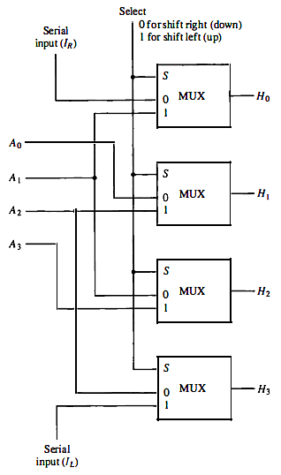
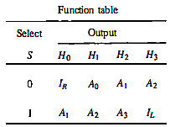
4 Bit Shifter

Slide 49
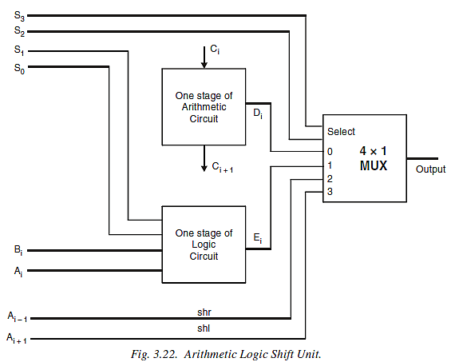
Arithmetic Logic Shift Unit

Slide 50
Assignment 1
What is Von – Neuman Architecture ? Explain with the help of Diagram and Example.
What is Common bus Organization ? Explain with the help of Example and Diagram.
What is BUS Arbitration ? Explain with the help of Example and Diagram.

Slide 51
BUS and MEMORY TRANSFER
A computer has many registers and paths must be provided to transfer the information from one register to another register. This transfer done by group wires called bus. To achieve a reasonable speed of operation, a computer must be recognized so that all its units can handle one full word of data. When data is transferred between units, all its bits are transferred in parallel, that is, the bits are transferred simultaneously over different wires. Many wires are required to establish the necessary connections. The number of wires will be excessive if separate lines are used between each register and all other registers in the system. A scheme for transferring information between the registers is a common bus system. Some control lines are required to manage the common bus system.
Bus: A group of wires that connected several devices to carry the data (or) information is called as a bus.
Bus Transfer: The data transfer between various blocks connected to the common bus is called bus transfer.
Memory Transfer: The data is stored (write) into memory or read from memory is called memory transfer.

Slide 52
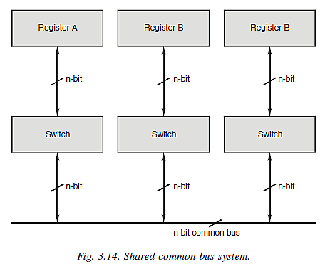
BUS TRANSFER
A more efficient scheme for transferring information between registers in a multiple register configuration is a common bus system.
It is shared by all the units. Switches are required to enable paths to be shared

Slide 53
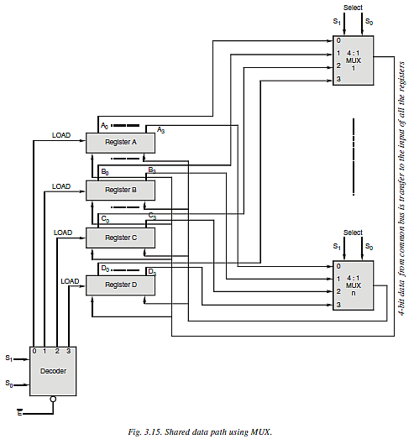
Shared Data path using MUX

Slide 54
Shared Data path using MUX
The multiplexers select one source register bus, and the decoder selects one destination register to transfer the information. The 4 bits in the same significant position in the register group go through a 4 to 1 multiplexer to form one line of bus. For n bit registers, n multiplexers are needed to produce an n-common line bus (or) shared data path. The transfer of information from the bus into its destination register is accomplished by activating load control of that register. If the decoder is not enabled, no information will be transferred between the registers.
The source register is B and the destination register is C. The multiplexer and decoder select the lines which satisfy the following condition to transfer the data from register B into register C.
MUX select line S₁S₀ = 01
Decoder select line S₁S₀ = 10
Decoder enable E = 0
When the select lines are equal to 01, all the MUXs are enabled and the second input places the content of B register to common bus. At next clock pulse, the content of B, being on the bus, is loaded into register C, when the decoder sends the load signal to register C, using S₁S₀ = 10.

Slide 55
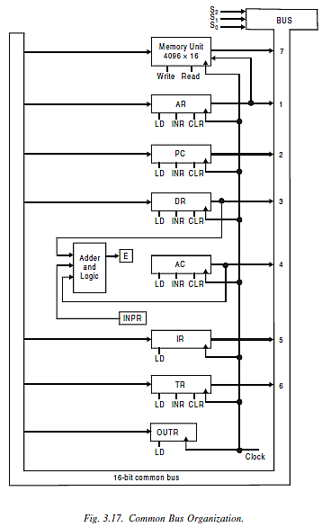
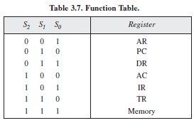
16-bit common bus receives information from six registers and the memory unit
five registers have three control signals LD (Load), INR (increment) and CLR (clear)
Two registers have only LD (load) control signal connected to the common bus
input register INPR and OUTR have 8 bits hence they communicate only with the 8 least significant bits in the bus
During a memory write operation the content of any register can be specified for the memory data and similarly during memory read operation any register except AC receives the memory data
in order to transfer contents of PC to Address Register, the computer requires the following instructions :
(1) Set the selection variables S2S1S0 = 010
(2) Transfer the contents of PC to the bus
(3) Enable LD input of AR
(4) Transfer contents of bus into AR

Slide 56
Thank You

